Slide 1

Whats new in Kofax RPA 11.1
David Wright
Partner Development Manager
Kofax

Slide 2
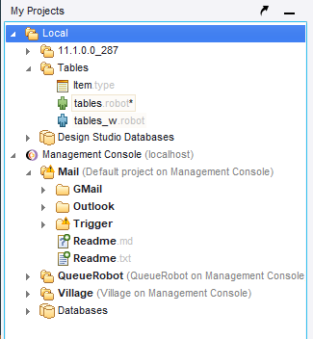
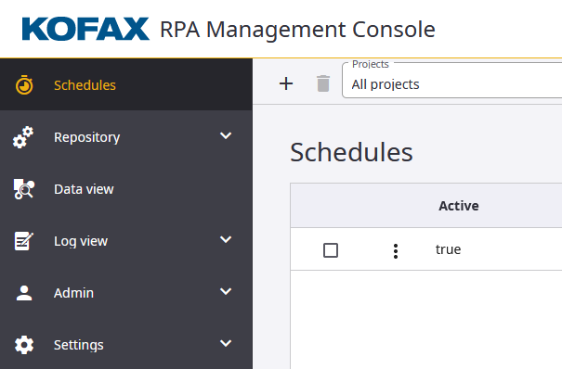
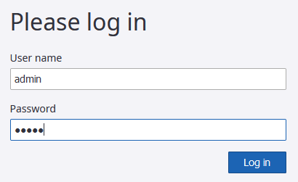
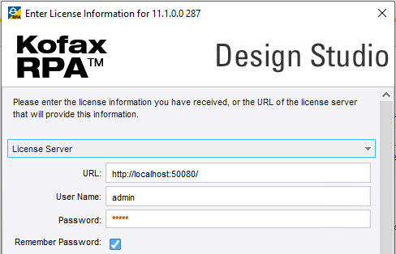
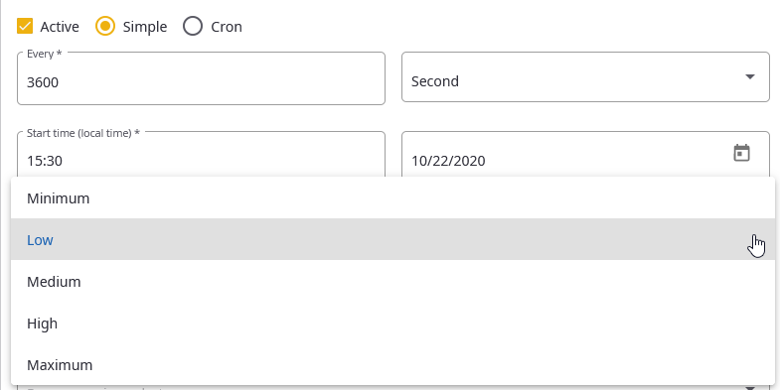
Kofax RPA 11.1 – what’s new
Management Console
User Management is permanently turned on. Default user is admin, password admin
New Management Console UI to conform with other Kofax Intelligent Automation products.
Scheduled Robot Priorities (advanced robot execution management)
Japanese version for Installers and the Entire Documentation.
Design Studio
My Projects panel simplified
Desktop Automation Robots can now be edited without the host Web Automation Robot open.
Robots that are not executing can be edited and copied.
Bulk extraction of DAR from WAR in project tree, since RPA 11 requires them to be different files.
Process Discovery Improvements
日本語

Slide 3






New features for Robots
“Web Automation Robot” Features
Incoming Email processing from GMail, Office365 or IMAP
Robots can now queue other robots, “fire and forget”
“Desktop Automation Robot“ Features
Kofax TotalAgility integration – documents and events
Document Transformation has metadata input
Chromium screen resolution; more print to pdf settings; download management
Kofax Omnipage OCR Engine now in Desktop Automation’s Intelligent Screen Automation (ISA)
Desktop robots can now have devices passed as parameters
New PDF viewer in Desktop Automation
60+ New Built-in Excel features, including named range awareness
Notes:
https://commons.wikimedia.org/wiki/File:Pdf_icon_file.png

Slide 4

Resources, Guides and Links for Kofax RPA 11.1
This presentation only gives
a high level overview.
Go to https://git.io/Jkt5H for
Step-by-Step guides
Sample robots
and links to
Product Documentation
Release Notes
This presentation
Other sites and resources

Slide 5
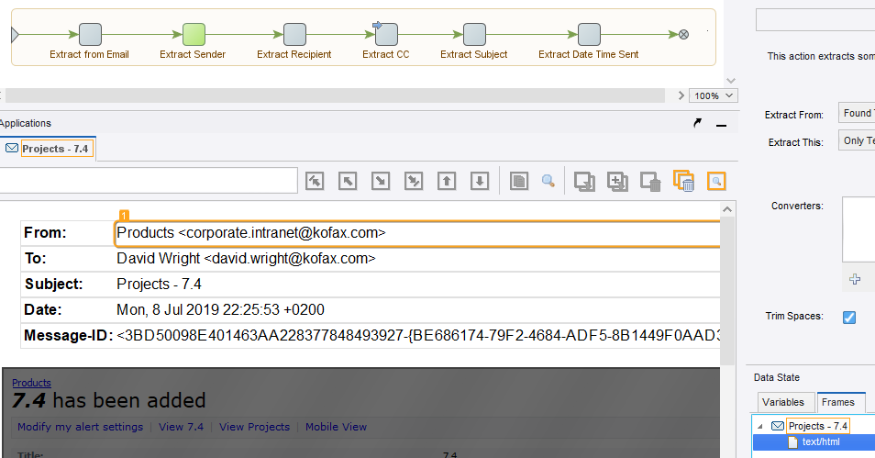
An email robot
Ignore&Continue
for optional fields
Enhanced Email Integration
You will need to click on Frames to access the email body
Extract from Email step uses a LongText input for the email in EML format
Email From, To, CC, Date, Subject, all Headers, Text & HTML Body and ALL attachments and images are available to the robot

Slide 6
Enhanced Email Integration
Trigger robots based on incoming emails.
Use email robots to answer simple questions or to forward emails based on 100’s of complex rules.
Process email attachments automatically.
Receive orders, payments, reports and forms
process the data immediately.
Many businesses send data to other business via PDF attachments
Combine Incoming Email with Robot Queueing and Robot Priorities
To process many incoming emails in parallel.
To distribute emails to hundreds of other robots.
To create jobs for each entry in an email attachment.
Supports Gmail, Office365 and any Email provider using IMAP.

Slide 7
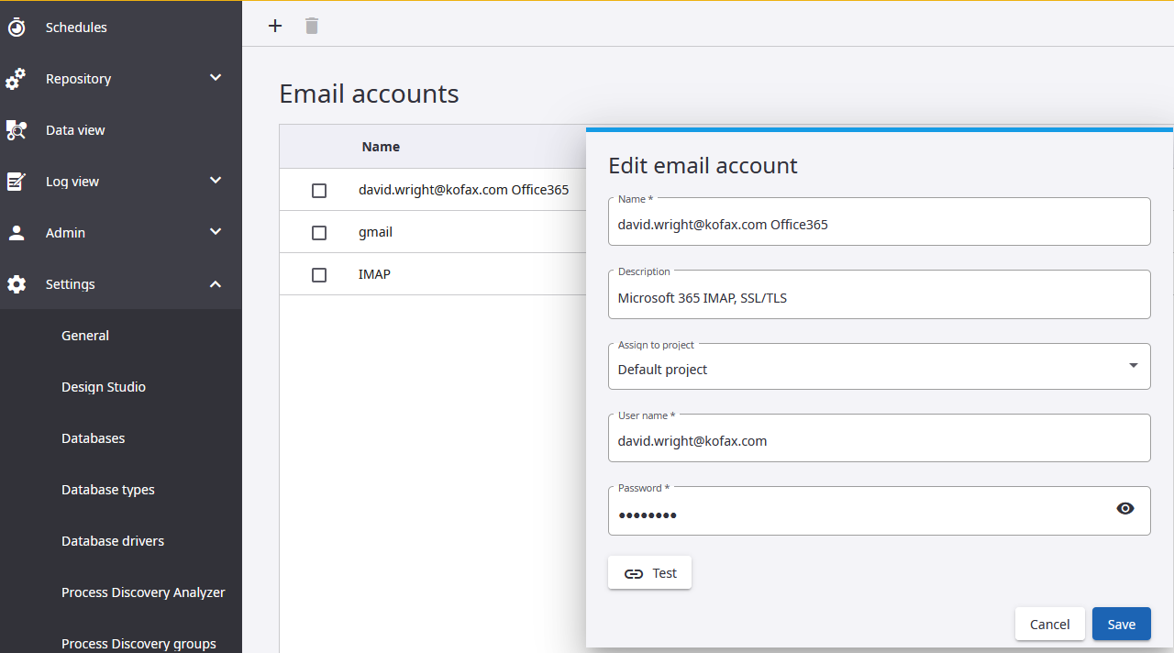
Configure Email accounts in Management Console/Settings
Enhanced Email Integration

Slide 8
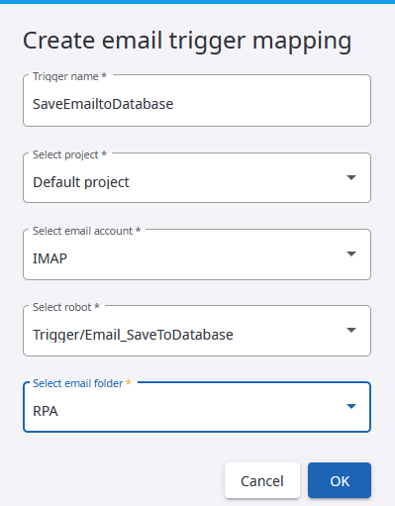
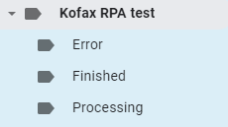
Configure Email trigger in Admin
Enhanced Email Integration
3 subfolders will be created on the Mail Server to handle emails
Select project
Depends on setup Email accounts
Depends on setup Robot
Fetches live from Email account

Slide 9

Robot Priorities in Schedules and Queues
PRIORITY
Minimum
Low
Medium
High
Maximum
Timeout Protection
A low priority task that is about to timeout will run before a high priority task with a long timeout.
Notes:
https://commons.wikimedia.org/wiki/File:Noun_Project_stopwatch_icon_386232_cc.svg

Slide 10



Robots can now Queue other robots
Fire and Forget. No waiting. No extra license needed.
One Excel document could queue 1000 robots.
Each queued robot generates a ticket number to track the progress – Queued, Running, Finished, Error
SCALABLE through PARALLELISM, maximize license usage.
Sell More Licenses!!
KILLER FEATURE
Notes:
Top hat: https://commons.wikimedia.org/wiki/File:TotalBiscuit_icon.png

Slide 11
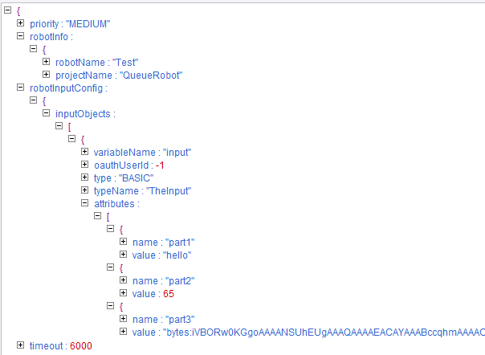
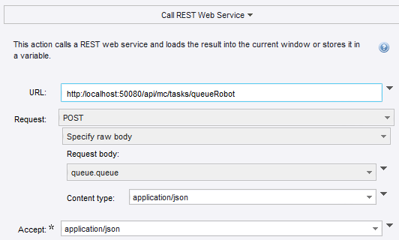
Robot Queueing
Use the Robot Step “Call REST Web Service” with JSON.
See resources for sample robots and Step-by-Step guide, and how to handle images and other binary files, and authentication.
Set PRIORITY & TIMEOUT (default = 6000 seconds = 10 minutes)

Slide 12
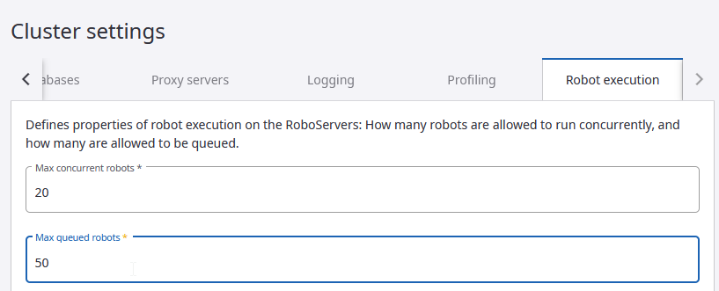
Queue Size

Slide 13
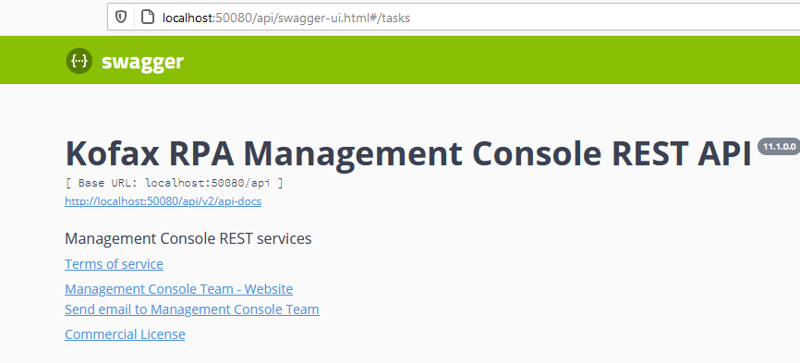
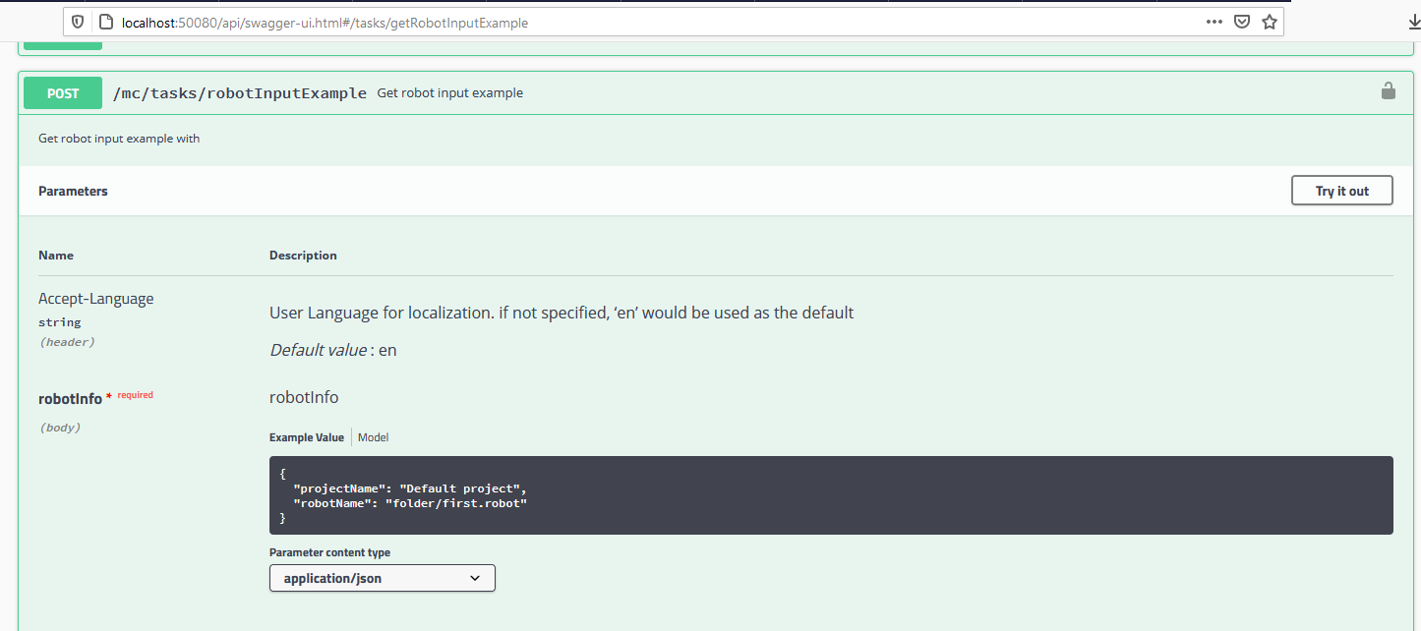
Brand-new REST API tool and tester. Great for setting up Queuing!
http://localhost:50080/api/swagger-ui.html
Shows you the JSON that your robot needs.

Slide 14
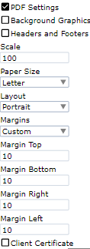
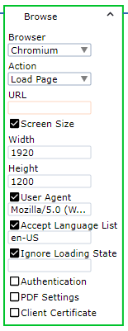
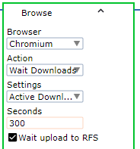
Chromium version 79 – Screensize, PDF, Downloading
Change Screen Width and Height for Chromium.
Tip! Change this to 800 wide so you can see the whole page and the close button.
This resolves memory problems with ISA and Image Finders on very long web pages.
Print to PDF has more settings. Page size!
Download control
Wait until long downloads have completed.

Slide 15

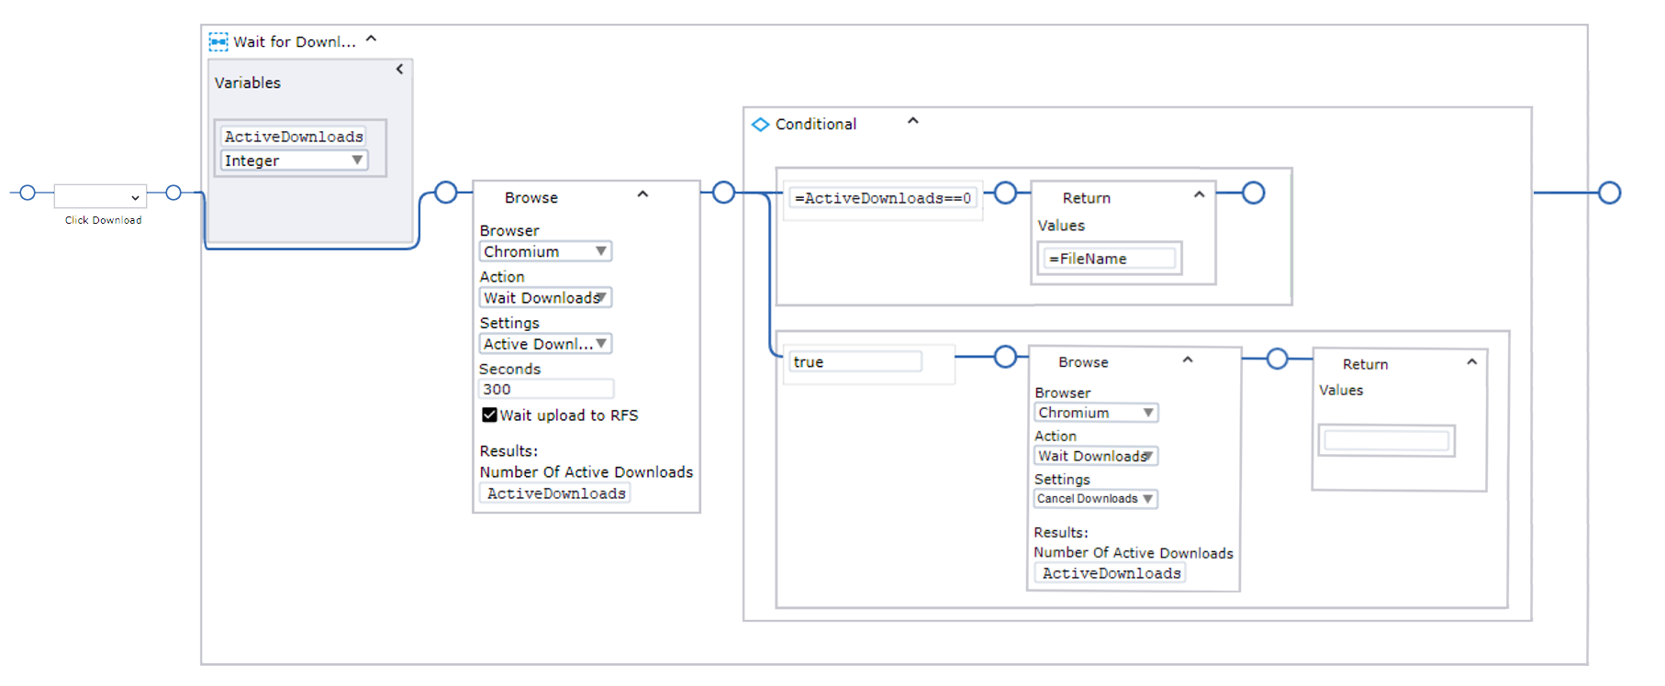
Wait for a download to complete in Chromium. Use Action “Wait Downloads” in Browse Step
Download succeeded
This workflow waits up to 5 minutes for a download to finish. If it fails to finish the download is cancelled.
If you want to wait even longer than 5 minutes, then put everything inside a loop, you can then wait as long as needed.
Download failed or 5 mins passed

Slide 16
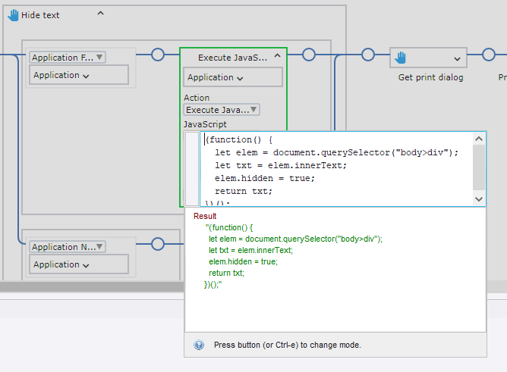
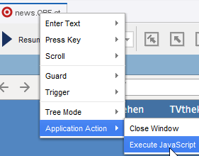
Chromium – Javascript Execution
This is found as an Application Action on the App Tab.

Slide 17
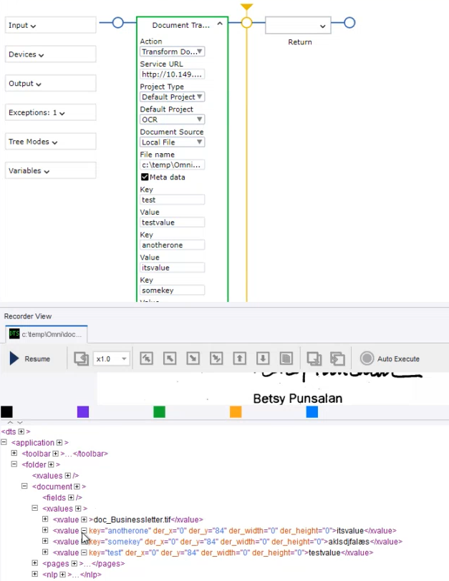
RPA & Document Transformation
Strengthen Intelligent automation Integrations
Robots can pass information about a document to Kofax Transformation using the well-known XValue mechanism, used by Kofax Capture and Total Agilty.
For example
Pass the language of a text for sentiment analysis.
Pass in customer details to check if they exist on the unknown document
This will require scripting in Kofax Transformation to use these values.

Slide 18
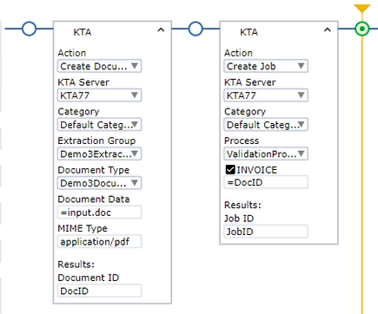
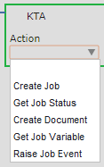
Kofax Total Agility Integration – 5 Actions
Strengthen Intelligent automation Integrations
Create job with a document – it’s really Kofax now!!
Config menus automatically update.

Slide 19
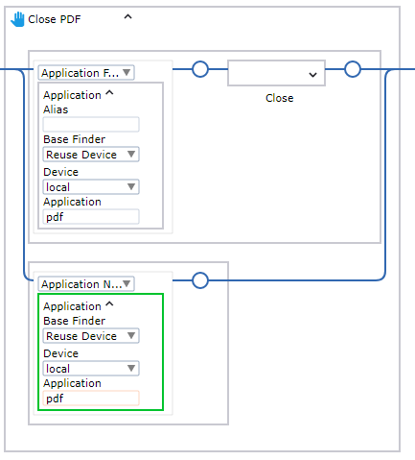
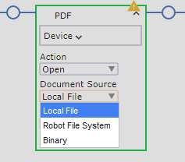
New PDF Viewer in Desktop Automation
General improvements
Access to Images, Text and Coordinates. Read those large PDF tables!
PDFs from File or Variable
Pass in PDFs from Web Robots
Tip. Use this workflow to prevent multiple PDF viewers appearing while testing!

Slide 20
Kofax OmniPage OCR Engine for “Intelligent Screen Automation” and “Extract Text from Image” is new in Kofax RPA 11.1
Google’s Tesseract is still the default OCR engine.
To enable Kofax Omnipage OCR you will need to edit
C:\Program Files\Kofax RPA 11.1\nativelib\hub\windows-x32\23\lib\ocr.cfg
# The OCR engine type. May be 'tesseract' (default) or 'omnipage'
# engine_type = tesseract
engine_type = omnipage
# Default OCR languages using ISO 639-3 B codes.
default_language = tur+eng
The robot cannot choose the language dynamically.
Arabic, Baltic, Chinese, Cyrillic, Dutch, Finnish, French, German, Greek, Hungarian, Italian, Japanese, Korean, Norsk, Polish, Portuguese , Sami, Slovenian, Spanish , Swedish, Turkish. (this list is not complete)
Don’t expect ISA to produce perfect OCR with Omnipage or Tesseract. If you need to read text perfectly, use the clipboard to extract it.

Slide 21

Process Discovery
Analyzer Cluster based on Apache Spark for more power in running detection.
Improved performance and stability.
Full resolution screenshots for steps.
Native UI support for Chromium.
Notes:
https://commons.wikimedia.org/wiki/File:Magnifying_glass_icon.svg

Slide 22
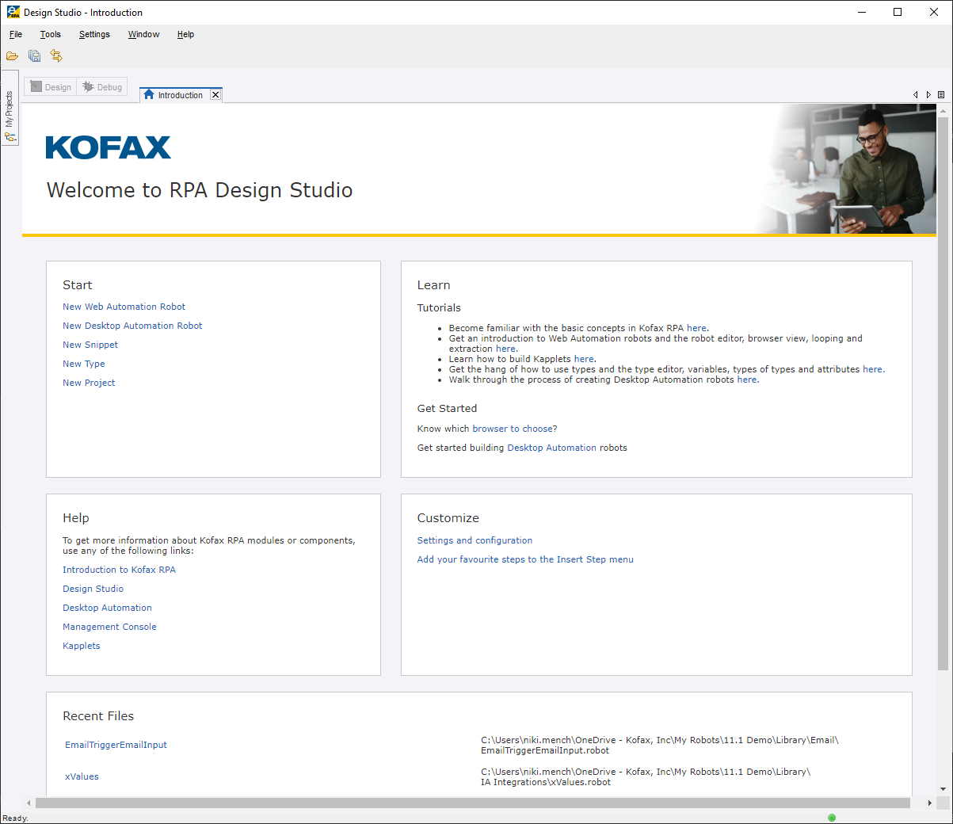
Introduction screen
Improved usability of Design Studio
Easier access to creating robots
Better visibility on tutorials and help section
Shortcuts to settings and configurations like favorited steps
Most recent robots
Localizable
White-label possible

Slide 23
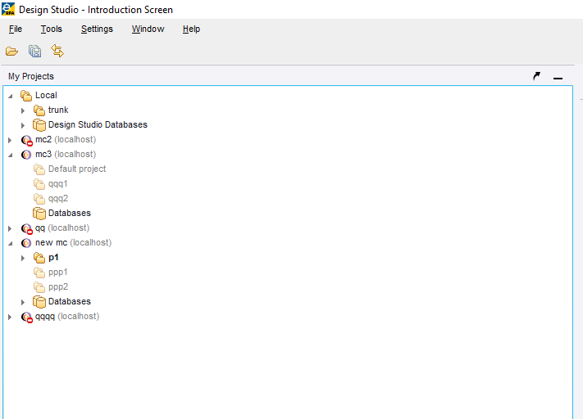
Unified Project view
Improved usability of Design Studio
Local projects and remote projects merged into a single view
Easier to manage multiple Management Consoles

Slide 24
Export of pre-11.0 robot
Improved usability of Design Studio
Making it easier to export Desktop Automation robots from Web Automation Robots
Preview tool is included
Guide to help the users through each step
Bulk export supported
Rename on the fly
Export report

Slide 25
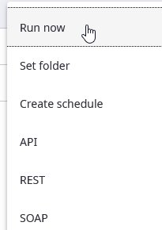
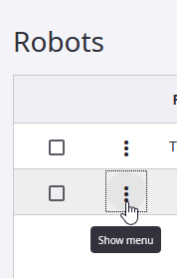
Run Now, API, REST, SOAP moved to … menu

Slide 26
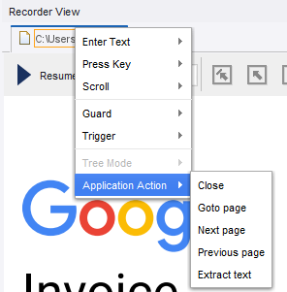
Application and component actions
General improvements
Actions makes it easier to insert operations in a robot
Keyboard focus
Application focus
Close Application
Next page

Slide 27

General improvements
Integration with SailPoint Identity Manager, Lookup of robot privileges (FR)
Shift to OpenJDK from Oracle Java SDK

Slide 28
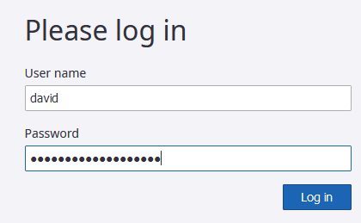
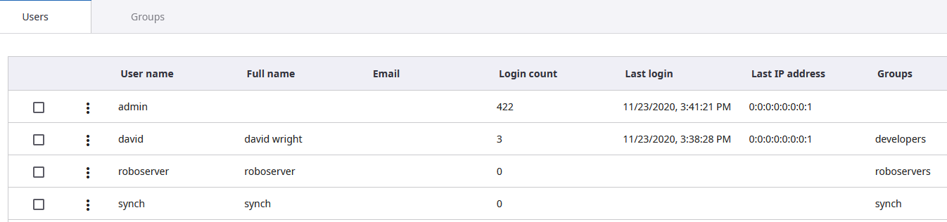
User Enablement
Tips
You must now login to Management Console and Design Studio.
You shouldn’t just use the super-user admin with password admin for everything
Create accounts for users, roboservers and services.
See basic guide https://git.io/Jk6bo
See advanced guide in Robot Lifecycle Management Guide https://git.io/Jk6bQ

Slide 29
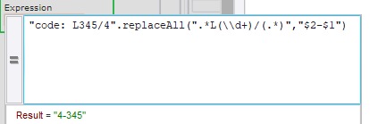
Desktop Automation supports regular expressions (regex) to extract values from text.
Tips
Here is how to extract the number in red and the number in blue, switch their order and put a dash between them
Input : Code: L345/4
Regular expression: .*L(\\d+)/(.*)
The () make “capture groups”. The first group is \\d+ and the second is .*. They are used in the replace step with $1 and $2.
In this example $1=345, and $2=4
The Output pattern of $2-$1 becomes “4-345”
You can experiment with this regex here https://regex101.com/r/fvuQyC/1

Slide 30
Thank you for your attention.
Enjoy building better robots!
David Wright
Partner Enablement Manager, Kofax

